Slide 1
protocol PPPoE

Slide 2

Who knows this signpost(תמרור) ?

Slide 3
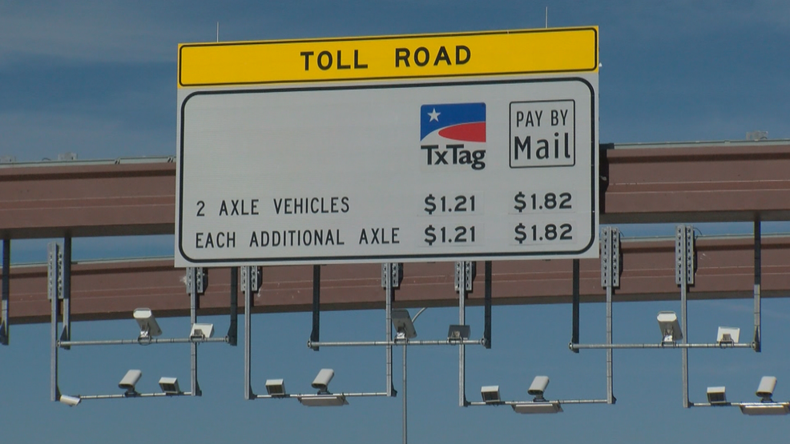

introduction
We all know what a toll road is
Advantages:
-Faster
-The road is safer
-Service providers:
Stuck with the car ?!
will come to extract you

Slide 4
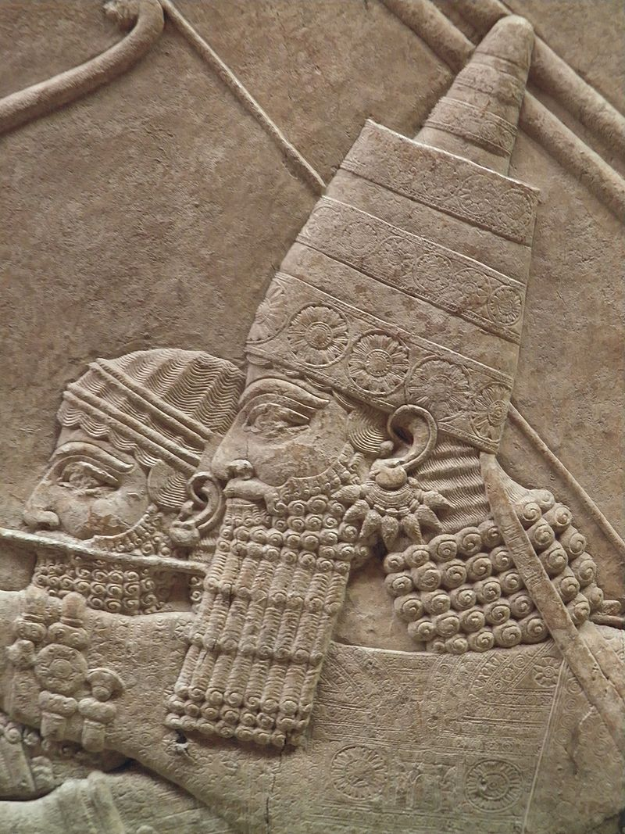
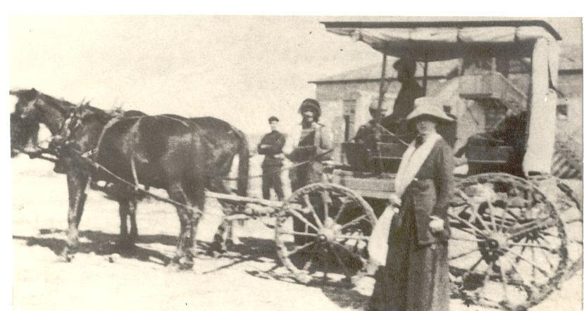
introduction
The toll road is not a new invention
The 2700 years ago passengers had to pay in Suza-Babel road under the reign of King Ashur-bnivel

Slide 5


introduction
Today we all have a way to navigate on the roads
(using Waze for example)
Now imagine the navigation service was not distributed to everyone
Instead of paving (לסלול) a new road, a car with GPS will drive consumers on existing roads
The driver is also a mechanic
Before giving service, the driver verifies that the consumer is a subscription

Slide 6
introduction
Advantages:
Encapsulation
The consumer is not driving, and the car is not registered in his name, the
consumer is encrypted in a package(car) - The traffic police do not know the consumer
Speed
The car will drive the fastest way
holding
If there is a car problem, the driver handles (remember he is a mechanic)
We were able to build a highway without paving a road

Slide 7
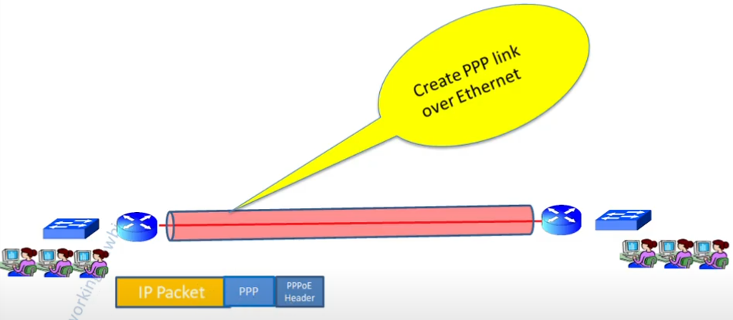

Slide 8
Let Start....
After this introduction we are ready to study the PPPoE protocol
PPPoE (open session - call the driver)
PPP
-PAP & CHAP (authentication - the driver verifies that the consumer)
-LCP (driver & GPS is working)
-encapsulation (i have a car - police not know me )
-session (the consumer goes into a car)
-L2TP (Layer 2 Tunneling Protocol for WAN)

Slide 9
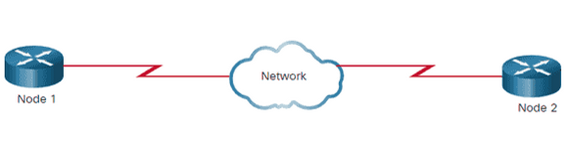
What is PPPoE
PPPoE is Point-to-Point Protocol over Ethernet
PPPoE relies on two standards
PPP
-PPP (Point-to-Point Protocol) is used to connect one computer system to another.
uses LCP(link control protocol) to establish a sission between a customer and ISP,
uses PAP/CHAP to authentication the customer
Ethernet

Slide 10
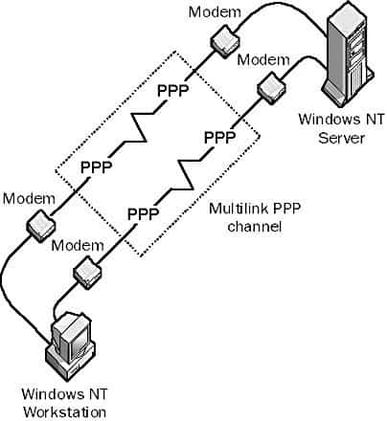
PPP
PPP(Point-to-Point Protocol)
is a TCP/IP protocol
that is used to connect
one computer system to
another

Slide 11

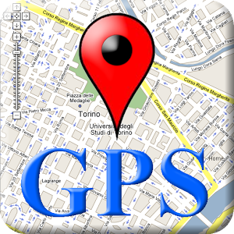

PPP
Components of PPP
1)Encapsulation
Low-level protocol, takes high level data(or protocols)
and puts into its frame
2) LCP Link Control Protocol
Responsible for creating and closing communication
3) security mechanisms:
-PAP (Password Authentication Protocol)
Responsible for consumer authentication
-CHAP (Challenge Handshake Authentication Protocol)
more secure
PPP
LCP
PAP
/
CHAP

Slide 12
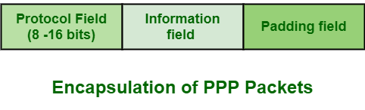
Encapsulation
PPP can carry multiple Layer 3 protocols over a single link.
To support multiple network layer protocols, PPP uses Protocol Type filed in header.

Slide 13
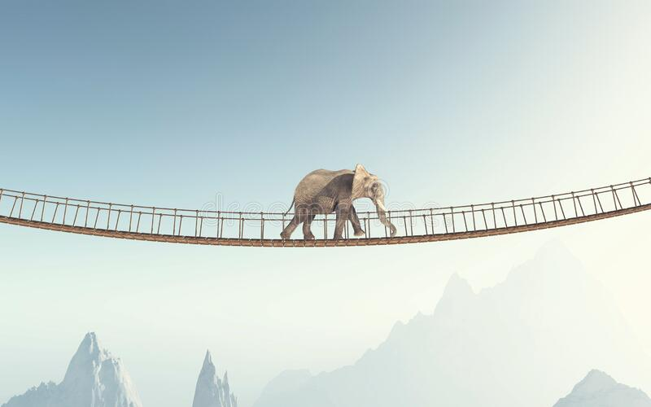
LCP
Error Detection
When PPP tries to communicate, it sends out LCP packets
The LCP packets check the communication line, to ascertain whether it can hold the data volume at the required speed
“We will go to check Can we
tell PPP to transfer the DATA”
PPP
LCP
LCP
LCP
It also identifies the linked peer and detects errors.

Slide 14
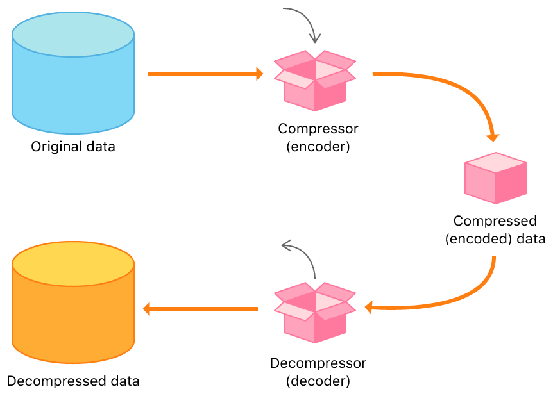
LCP
Compression
LCP compression data at sending end
and Decompress data at receiving end.
With compression increases the data transfer speed

Slide 15

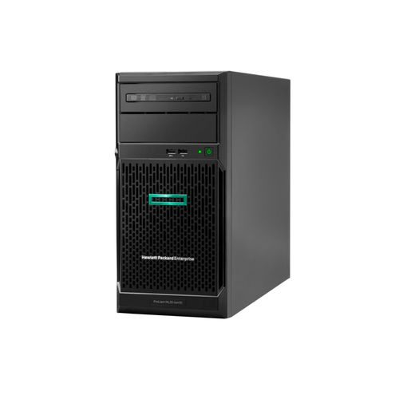
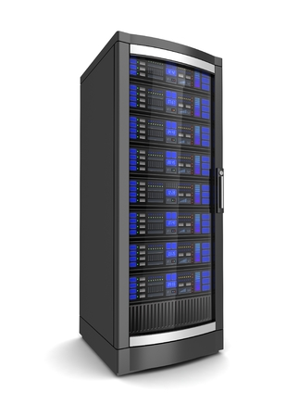
PAP
The network access server requests a password from the client(text) and sends the retrieved password to an authentication server for verification.
as a single LCP package
internet
password
password
client
network access
server
authentication
server

Slide 16
CHAP
the network access server sends a challenge message(random value) to the client
The client encrypts(מצפין) the challenge message with a user’s password and sending back the combination
The access server forwards the combination to the authentication server.
The authentication server encrypts the challenge with the user’s password stored in the authentication database.
random
random
combination
combination
password
client
network access
server
authentication
server

Slide 17
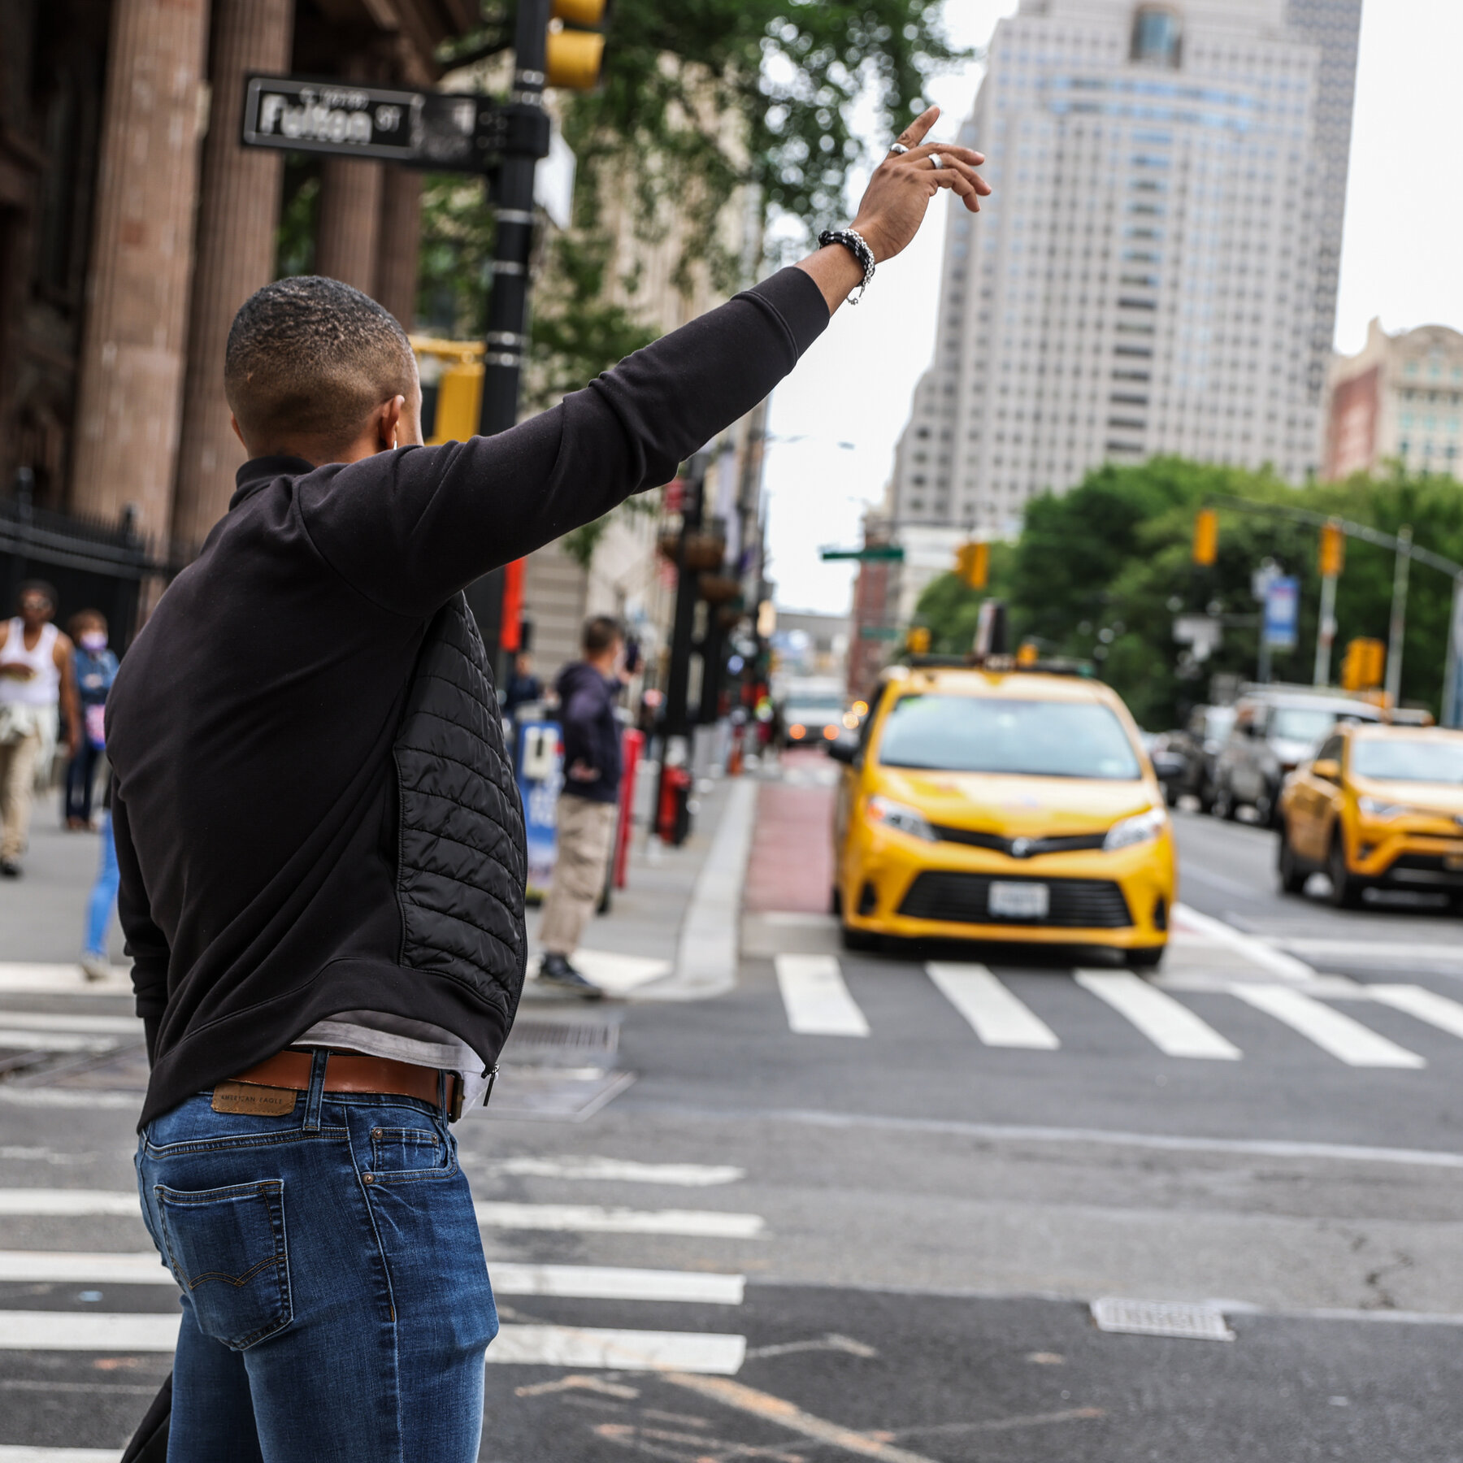
“Texiii....oops...session”
A link between 2 points allowing data transfer is called "session"
(Each trip of a consumer in the car...each ppp link)
But how will we catch a session ?
session
With PPPOE protocol we can open session
but just after 4 Discovery stage:
PADI - Initialization
PADO - Offer
PADR - Request
PADS - Session
{like DHTP Discovery}

Slide 18
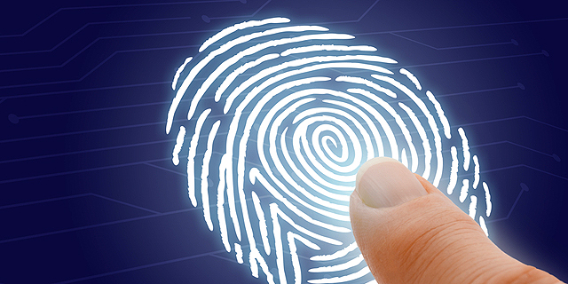
PPPoE Session Stage
The PPPoE session stage starts after the PPPoE discovery stage is over
Each PPPoE session is uniquely
identified by session ID
(Created a pipe with 256 uses for security reasons)
After the PPPoE session is established, data is sent as in any other PPP encapsulation.
The PPPoE information is encapsulated within an Ethernet frame and is sent to a unicast address.

Slide 19
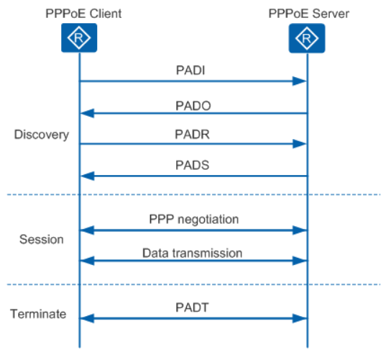
Summary
pppoe client
pppoe server
A unique PPPoE session established in Discovery stage
PPP connection establish in the Session stage, then data transferred on the PPPoE link.
Both PPPoE client or server send the PADT in the Terminate stage to terminate the PPPoE session.

Slide 20
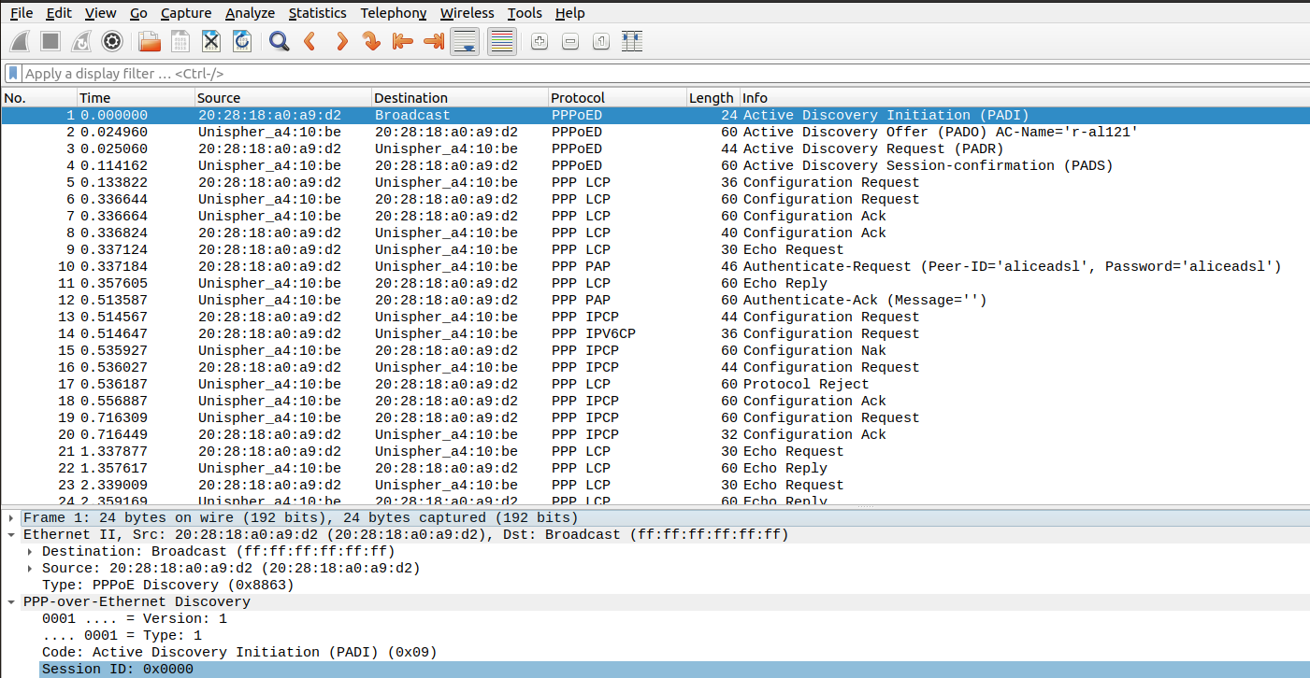
wiresharl
broadcast
Still not opened session

Slide 21
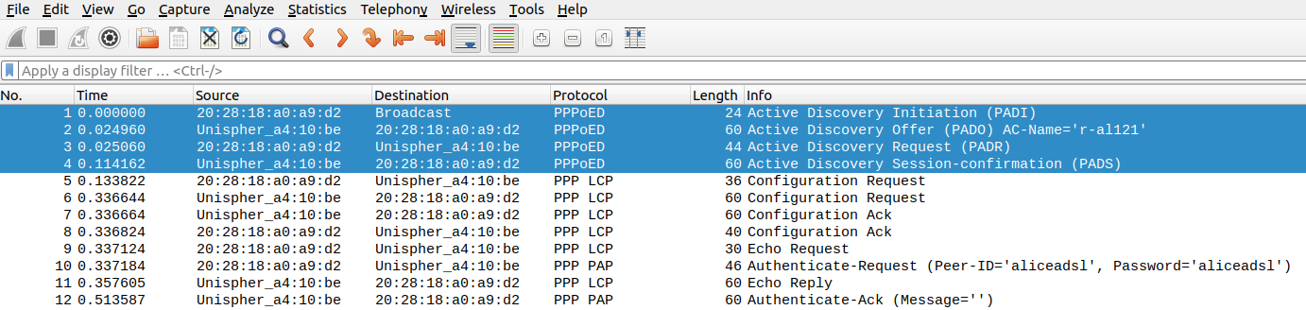
4 DISCOVERY STAGES

Slide 22
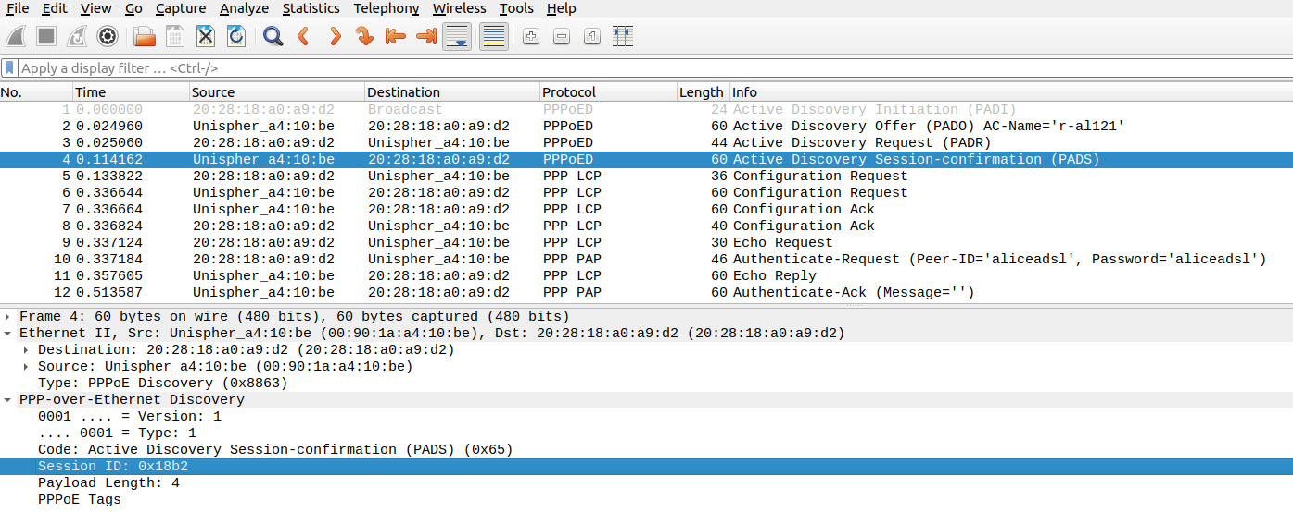
Gets session
Same session

